Slide 1
Text Mining
L10. Biomedical text mining

Slide 2
Today’s lecture
Quiz about week 9
Biomedical text mining: motivation
Biomedical research questions that can be answered with TM
Exercise
Text mining modules in the biomedical domain
State of the art

Slide 3
Quiz about week 9
Suppose we have customer reviews with scores 1-5 and we are asked to train a model to predict a score given a review text. What kind of problem is this?
Multi-class classification
Multi-label classification
(Ordinal) regression

Slide 4
Quiz about week 9
What is the challenge of an adjective such as 'heavy' in aspect-based sentiment analysis?
In some contexts it expresses sentiments, but in other contexts it does not
It can be positive for one product, and negative for another product
It can be positive for one aspect, and negative for another aspect
All of the above

Slide 5
Quiz about week 9
Suppose we have binary sentiment classification, positive vs negative. How is the recall for the negative class defined?
Of all messages automatically classified as negative, how many are correct
Of all messages with true label negative, how many are classified correctly
Of all messages, how many are negative

Slide 6
Biomedical text mining

Slide 7
Motivation
Large amount of scientific literature in the biomedical domain
Needed for
Assessing all prior work on a specific topic (systematic review)
Building knowledge bases of relations between biomedical entities
Building research hypotheses that subsequently can be experimentally validated
Extracting metadata for large experimental datasets
The number of articles that are added to the literature databases (MEDLINE/PubMed) is growing fast

Slide 8
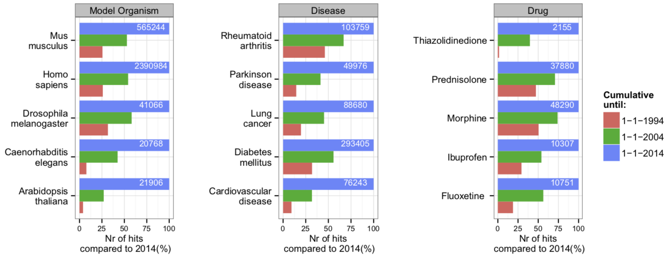
PubMed growth
Fleuren and Alkema (2015). Application of text mining in the biomedical domain

Slide 9
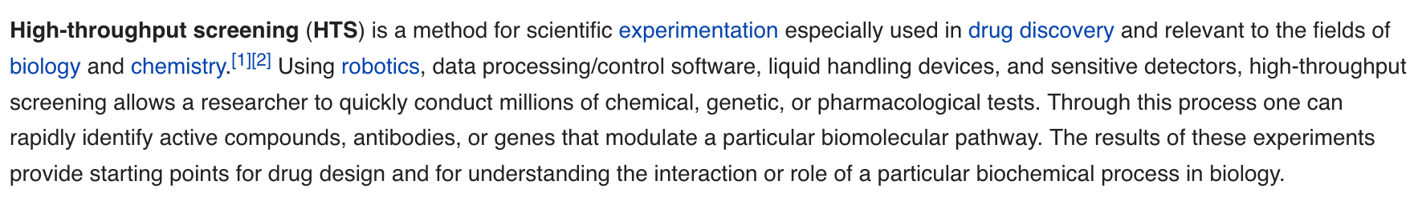
Data size growth
Not only exponential growth of the scientific literature,
but also of experimental data
E.g. for gene expression profiling or proteomics experiments, regulation of hundreds or thousands of genes and proteins is measured under multiple experimental conditions
And of patent data, social media data, electronic health records, …

Slide 10
Goals
Interactive knowledge discovery: assisting the expert in finding the information they need
Text Mining can assist researchers in
finding, evaluating and interpreting the scientific literature and patented biomedical inventions
generating new medical hypothesis using information extracted from patient information (health records, social media data)

Slide 11
Biomedical research questions
that can be answered with TM

Slide 12
Text Mining for biomedical research
Gene/protein/disease extraction
Adverse events (side effects)
Predictive models for electronic health records
Predicting diagnosis codes (discover misclassifications)
Predicting time-to-death
Predicting hospital discharge
Classifying the urgency of medical situations
Drug interactions

Slide 13
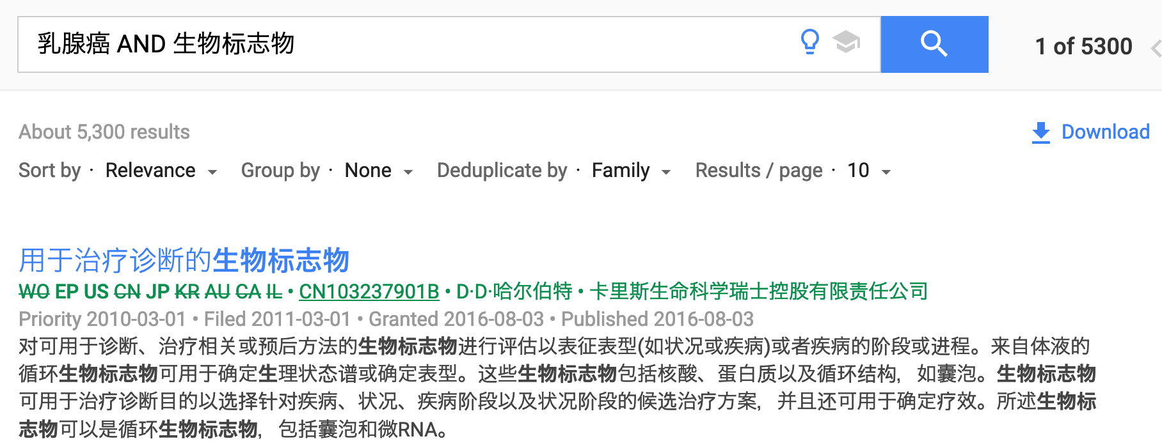
gene/protein/disease extraction
GNormPlus: a tool for tagging genes, gene families, and protein domains
How about non-English texts?

Slide 14
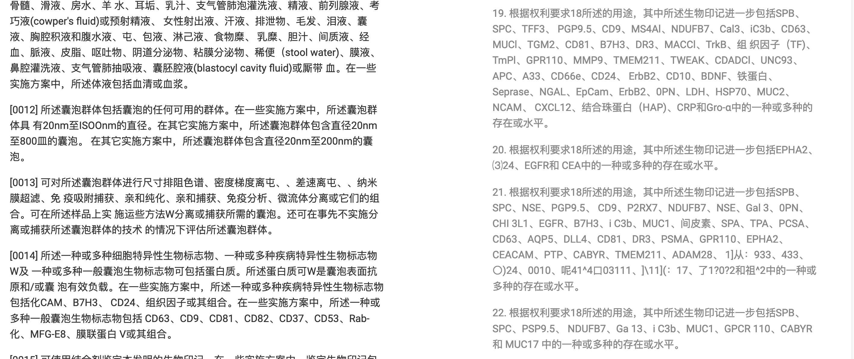
gene/protein/disease extraction

Slide 15
Adverse events
Mine adverse effects from medical case reports
Adverse Drug Effect (ADE) benchmark corpus
a set of nearly 3000 case reports
manually annotated with 5063 drugs and 5776 conditions
+ ontology of adverse events
“With these methods, a number of drug label changes for the drugs rituximab, efalizumab, and natalizumab could successfully be predicted”

Slide 16
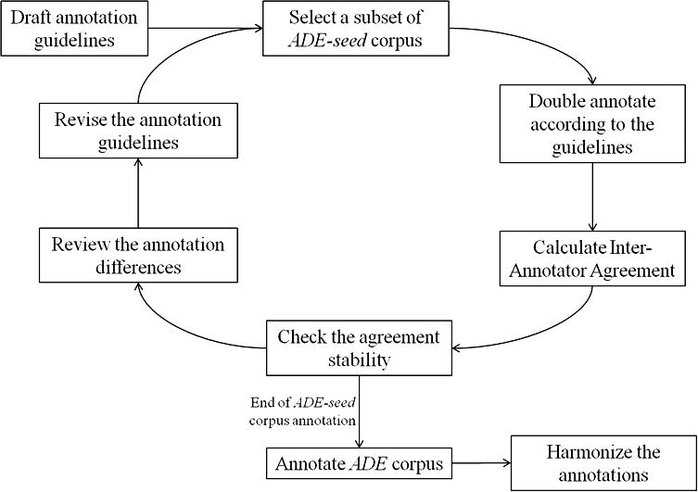
ADE benchmark corpus
H. Gurulingappa et al., Development of a benchmark corpus to support the automatic extraction of drug-related adverse effects from medical case reports J. Biomed. Inf. 45 (5) (2012) 885–892.

Slide 17
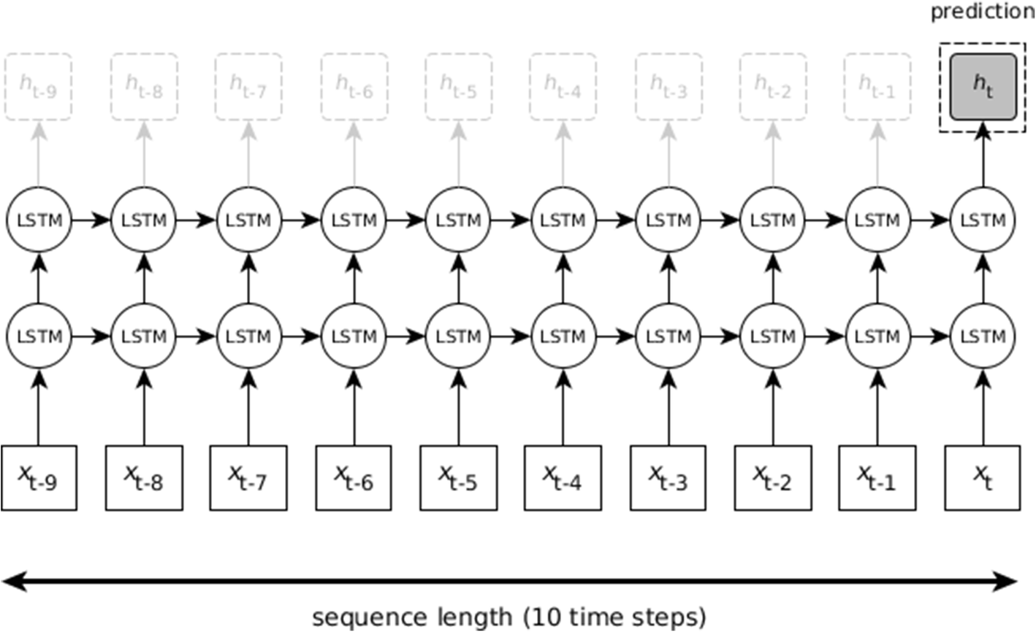
Predictive models for EHRs
“The model creates a probability distribution by predicting the chance that the end of life will occur during each specific month.”
Merijn Beeksma, Suzan Verberne, Antal van den Bosch, Iris Hendrickx, Enny Das, Stef Groenewoud (2019). Predicting life expectancy with a long short-term memory recurrent neural network using electronic medical records. BMC Medical Informatics and Decision Making. 19:36. https://doi.org/10.1186/s12911-019-0775-2

Slide 18
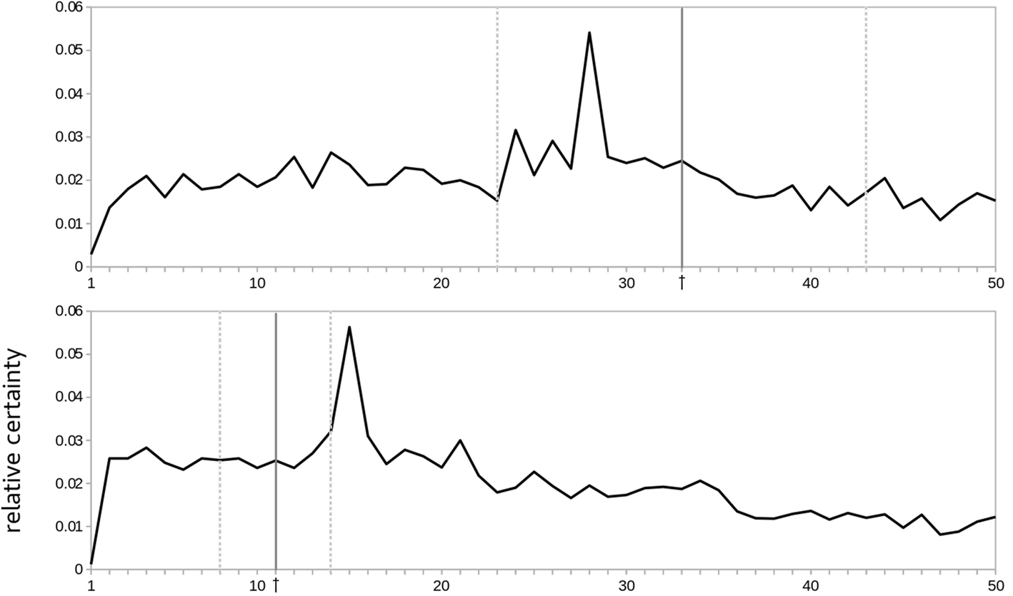
Predictive models on EHRs

Slide 19
Exercise

Slide 20
What is needed for Bio-TM?
Task: find side effects for medications in online cancer patient forum discussions
How would you approach this? What do you need?

Slide 21
What is needed for Bio-TM?
Steps to take
Needed
Get/create training data for NER
Identify drug names and side effects in the messages
Extract cooccurrences of drug names and side effects in one message
Normalize the side effects (map to ontology)
Match the found relations to an existing knowledge base to identify which relations are new
Lists/ontologies of drug names and known side effects (e.g. SNOMED CT)
Pre-processing (spelling correction)
Labelled data for supervised NER and evaluation

Slide 22
Normalization
“An hour after taking Gleevec, I start to feel tingling in my upper and lower leg”
“Does anyone else experience a tingly feeling when using Gleevec?”
“I stopped using Gleevec because the pain in my legs drove me crazy”

Slide 23
Bio-TM Modules

Slide 24
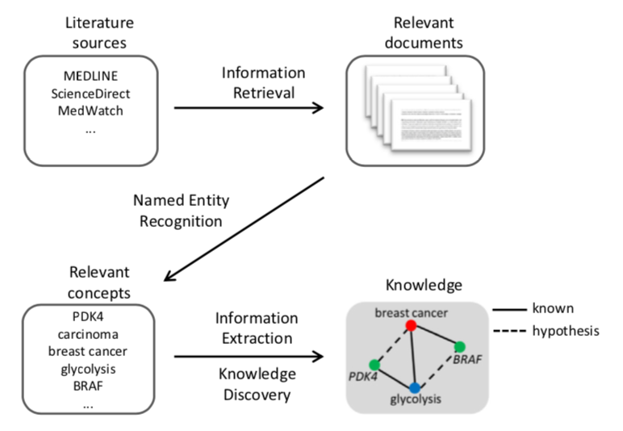
Modules in Bio-TM
Information Retrieval
Named Entity Recognition and ontology linking
Relation Extraction
Knowledge Discovery
Visualization
Fleuren and Alkema (2015). Application of text mining in the biomedical domain

Slide 25
Information Retrieval
Most used IR system: PubMed
Underlying database: MEDLINE
MEDLINE has full text papers and annotated abstracts with Medical Subject Heading (MeSH) Terms.
Search terms: formulated by expert (query)

Slide 26
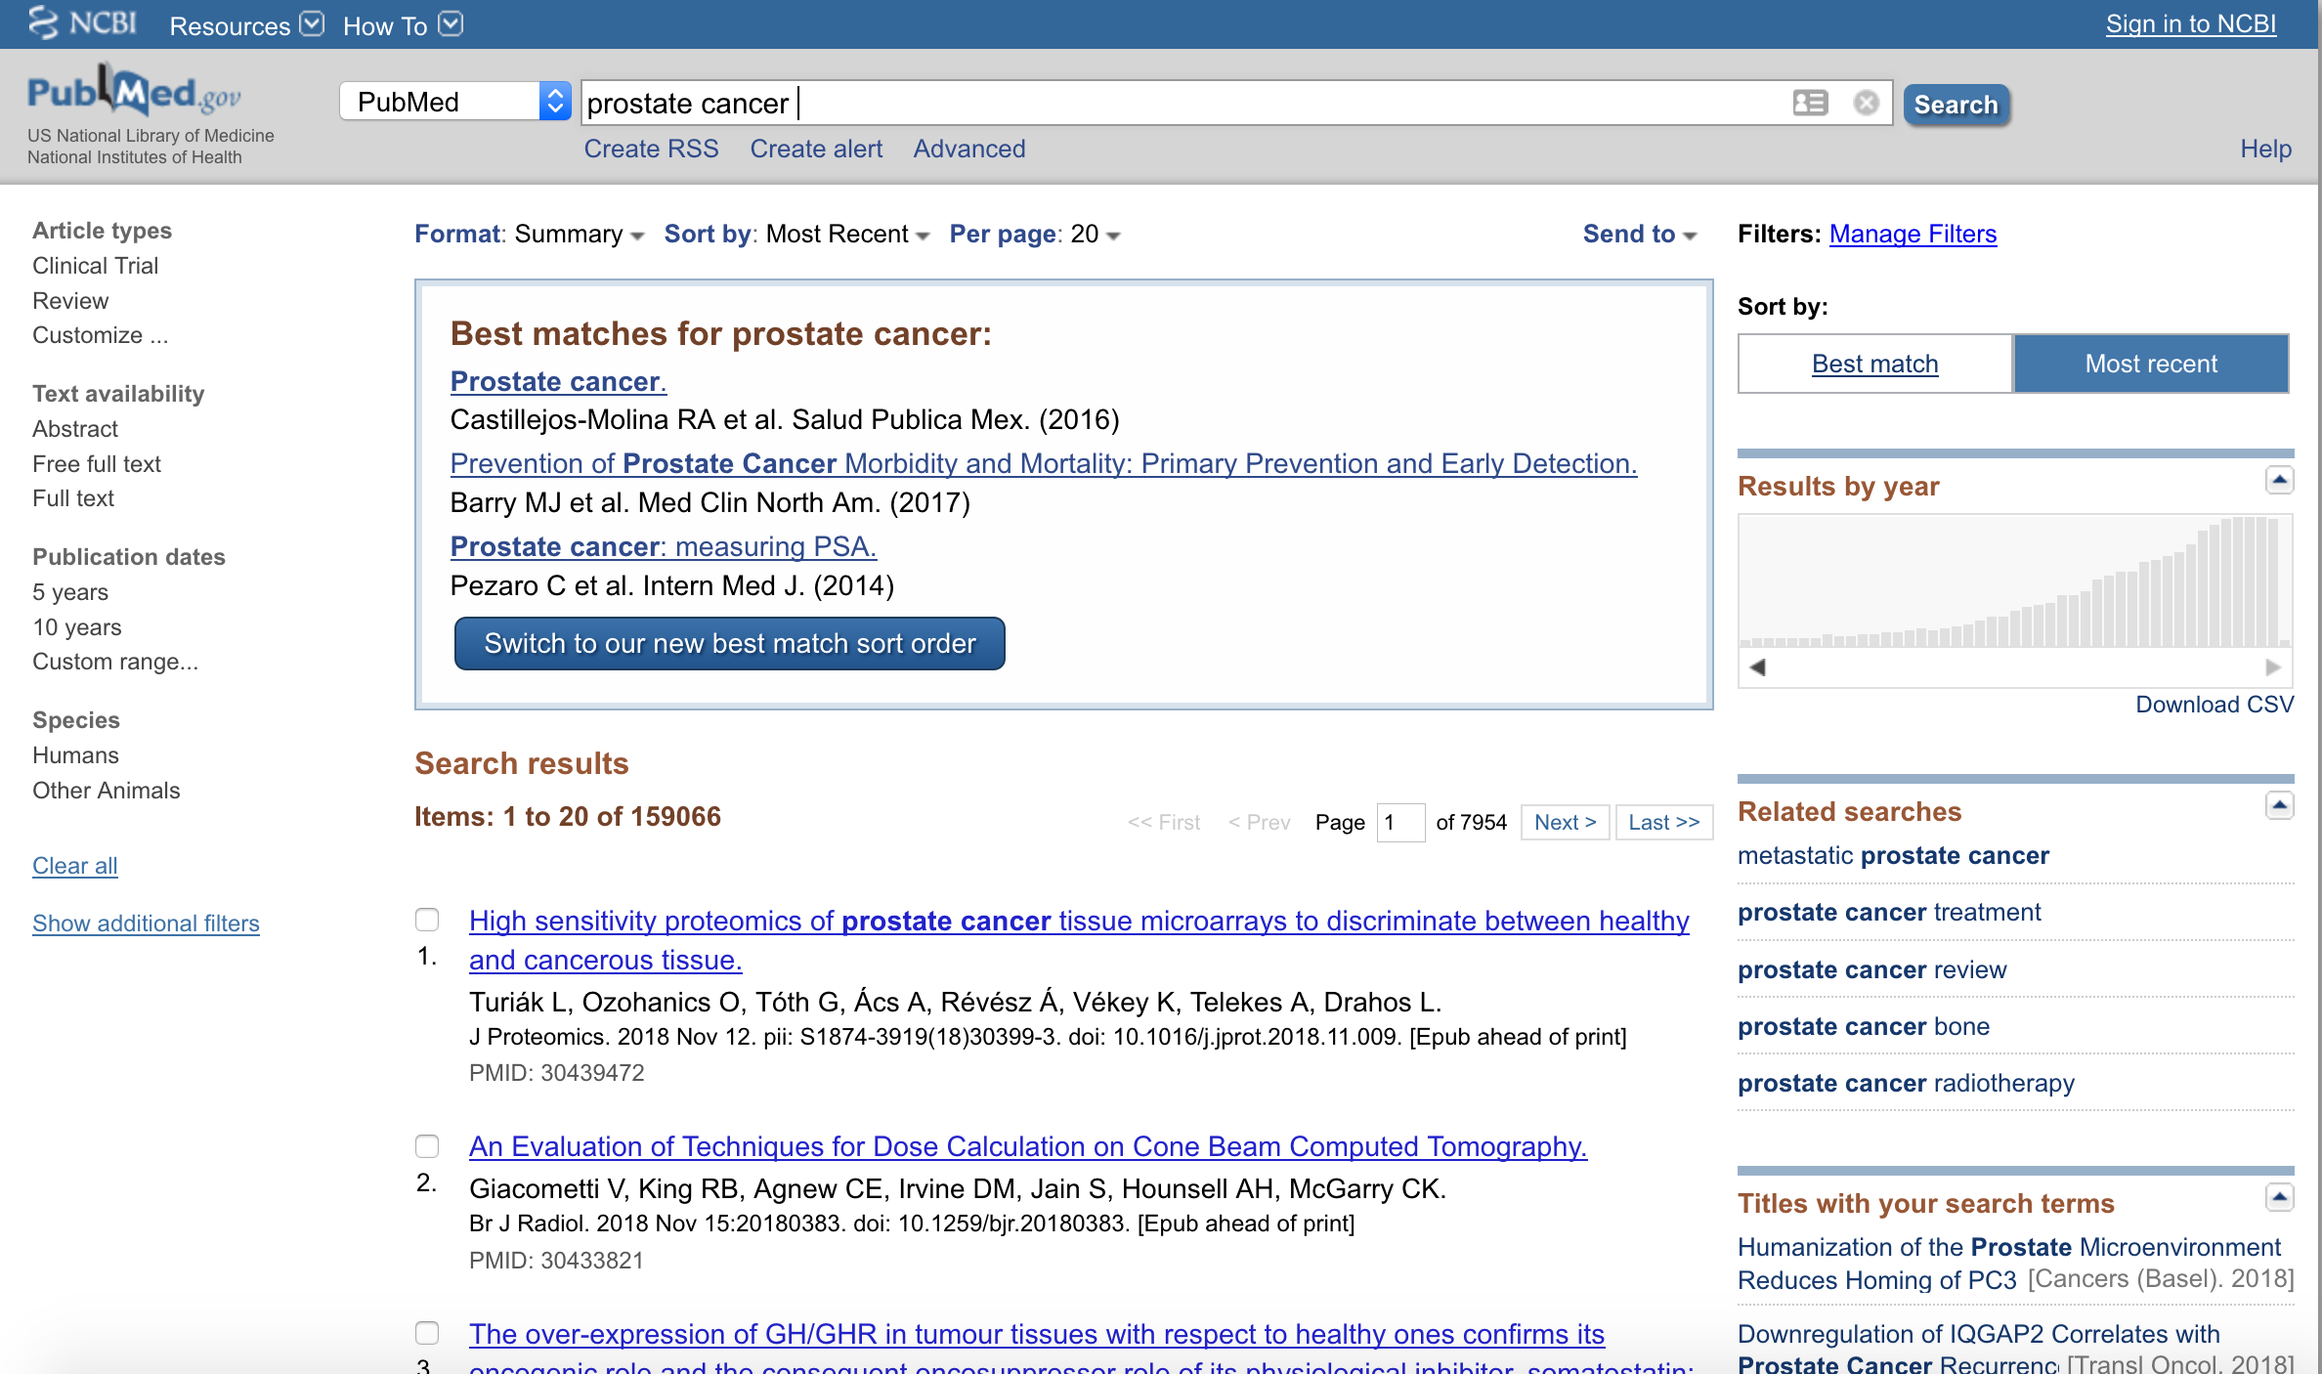
pubMed

Slide 27
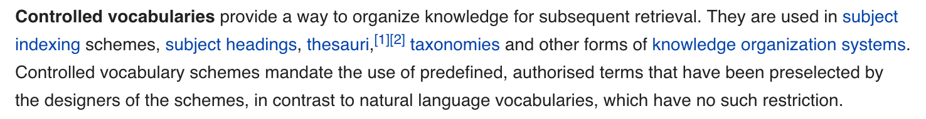
Information Retrieval
TM systems sometimes have advanced query options:
‘concepts’: organizing similar keywords such as synonyms and alternative names into one concept based on a controlled vocabulary and subsequently incorporating all keywords of the same concept into the query.

Slide 28
Named Entity Recognition

Slide 29
Named entity recognition
Identifying biomedical entities in retrieved documents
Mentions of entities are highlighted and linked to the specific concept in a controlled vocabulary (thesaurus or ontology)
Unified Medical Language System (UMLS)
“The UMLS integrates and distributes key terminology, classification and coding standards, and associated resources to promote creation of more effective and interoperable biomedical information systems and services, including electronic health records.”
Ambiguity and variation are challenges

Slide 30
Bio-NER
One of the biggest challenges of bio-NER is the recognition of genes and protein names in scientific text
These are often described using different names and symbols and multiple genes share symbols and names
“Results from the gene normalization task of the BioCreative II contest underline this challenge, since none of the participating systems was able to correctly extract all human genes from a set of expert-curated MEDLINE abstracts”
(experts agreed in 90–95% of the cases)

Slide 31
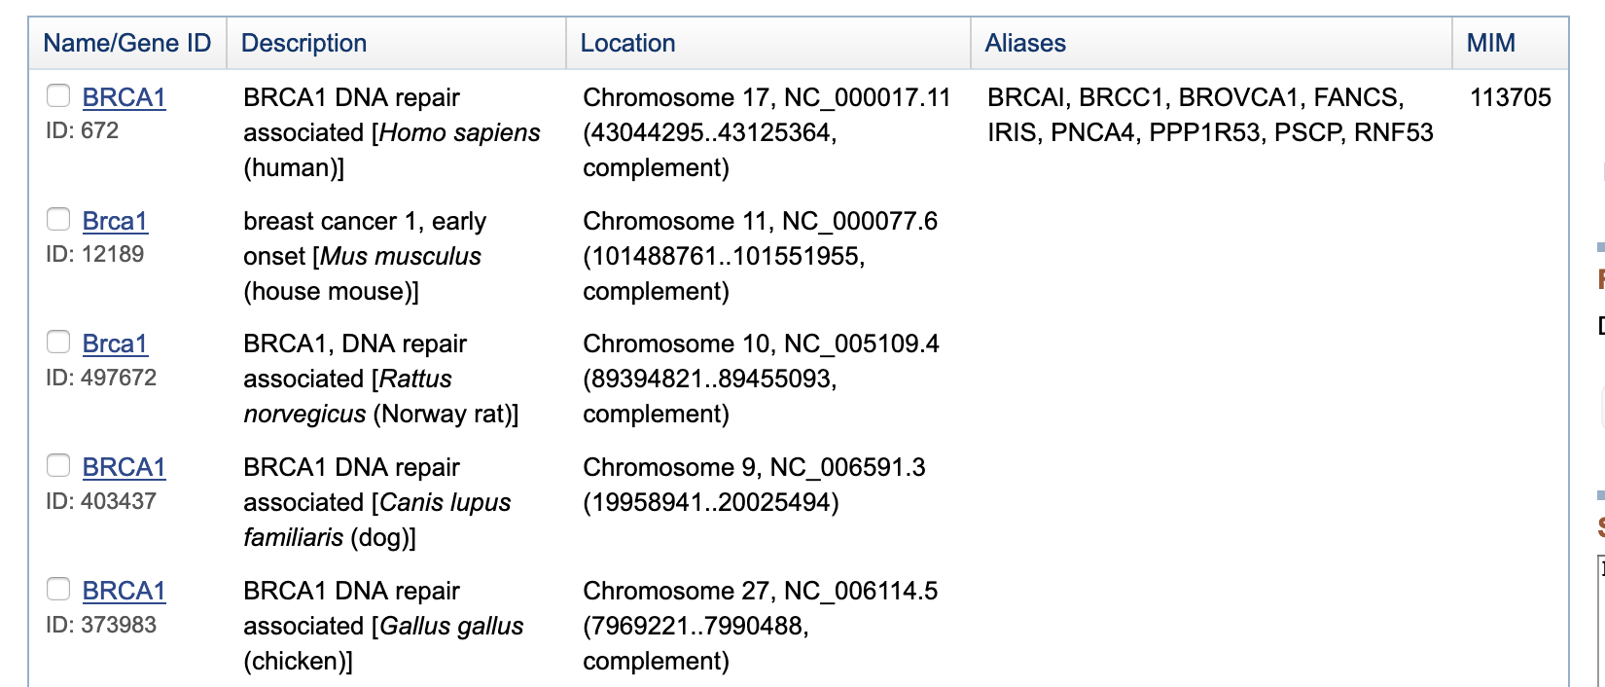
Gene names
https://www.ncbi.nlm.nih.gov/gene

Slide 32
Bio-NER
Unsupervised NER: linking terms to concepts in an ontology
A number of dedicated ontologies are available in the public domain
https://bioportal.bioontology.org/
ULMS, Snomed-CT

Slide 33
Bio-NER
Supervised NER: machine learning
Training data needed
Use cases:
Medication names and side effects in health records
Gene, protein and disease names in patent data
Side effects in forum data

Slide 34
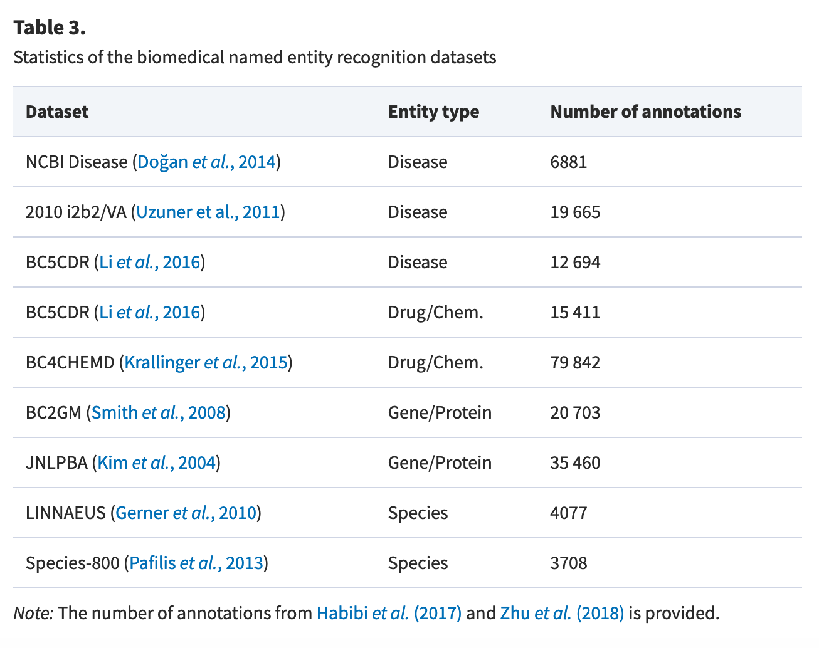
Bio-NER
Benchmark data for biomedical NER
Lee et al (2020). BioBERT: a pre-trained biomedical language representation model for biomedical text mining. https://academic.oup.com/bioinformatics/article/36/4/1234/5566506

Slide 35
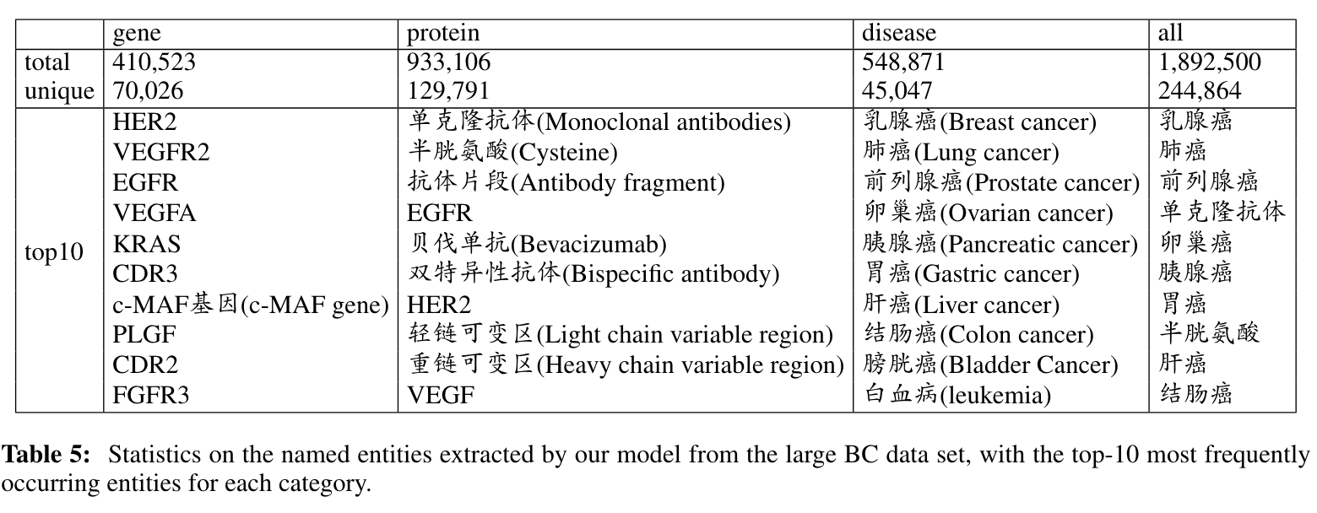
Other languages than English
Biomedical entities extracted from a Chinese patent dataset related to Breast cancer
Yuting Hu and Suzan Verberne (2020). Named Entity Recognition for Chinese biomedical patents. In the Proceedings of the 28th International Conference on Computational Linguistics (COLING)

Slide 36
Relation extraction and Knowledge discovery

Slide 37
Relation extraction
Co-occurrence-based methods
NLP-based methods

Slide 38
Relation extraction
Co-occurrence based methods assume that two concepts that often occur together in the same text are related
E.g. the co-occurrence of retinol-binding protein 4 (RBP4) and insulin resistance in MEDLINE abstracts suggests a functional relationship between gene and disease

Slide 39
Relation extraction
Co-occurrence based methods assume that two concepts that often occur together in the same text are related
E.g. the co-occurrence of retinol-binding protein 4 (RBP4) and insulin resistance in MEDLINE abstracts suggests a functional relationship between gene and disease

Slide 40
Relation extraction
Co-occurrence based methods assume that two concepts that often occur together in the same text are related
E.g. the co-occurrence of retinol-binding protein 4 (RBP4) and insulin resistance in MEDLINE abstracts suggests a functional relationship between gene and disease
Statistics for co-occurrence frequencies:
actual number of cooccurrences
expected number of cooccurrences based on the frequencies of both entities
a statistical test to decide if the cooccurrence is statistically significant (e.g. Chi-square. Null hypothesis: they are independent)
https://think-lab.github.io/d/67/

Slide 41
Relation extraction
Structure-based methods are phrase based and are able to detect triples in text e.g. gene A inhibits gene B or gene C is involved in disease G
Provides information about the type of relationship between two concepts
Structure-based methods often have a higher precision than co-occurrence based methods but lower recall (limited set of relations)

Slide 42
Visualisation
Networks of entities and relations (in this case genes)
Part of the gene–gene connection network for the human gene dataset.
The BRCA1 gene network generated from our breast cancer dataset. Nodes in red circles are the nodes that are also related to BRCA1 in the STRING database.
Yuting Hu and Suzan Verberne (2020). Named Entity Recognition for Chinese biomedical patents. In the Proceedings of the 28th International Conference on Computational Linguistics (COLING)

Slide 43
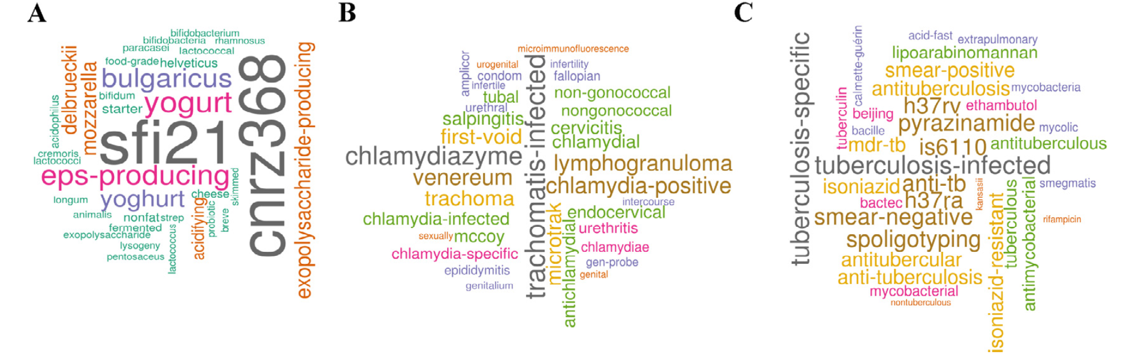
Visualisation
Word clouds
Word clouds were produced from highly occurring keywords in MEDLINE abstracts about Streptococcus thermophilus (A), Chlamydia trachomatis (B) and Mycobacterium tuberculosis (C)

Slide 44
State of the art

Slide 45
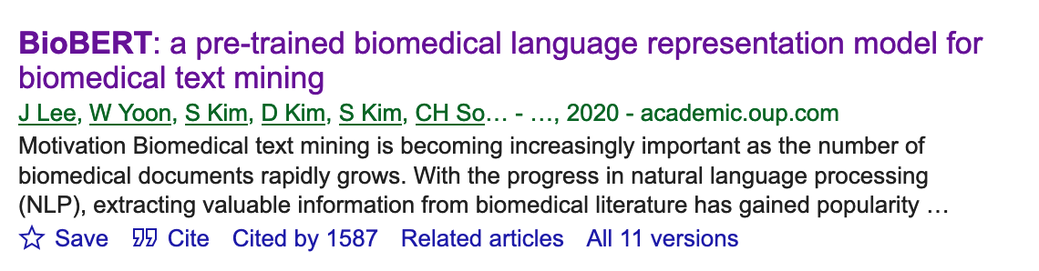
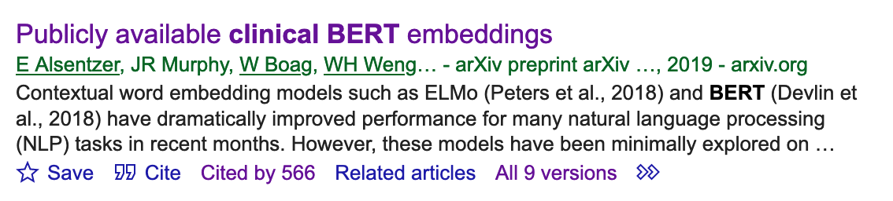
BioBERT and ClinicalBERT
https://academic.oup.com/bioinformatics/article/36/4/1234/5566506
https://arxiv.org/abs/1904.03323

Slide 46
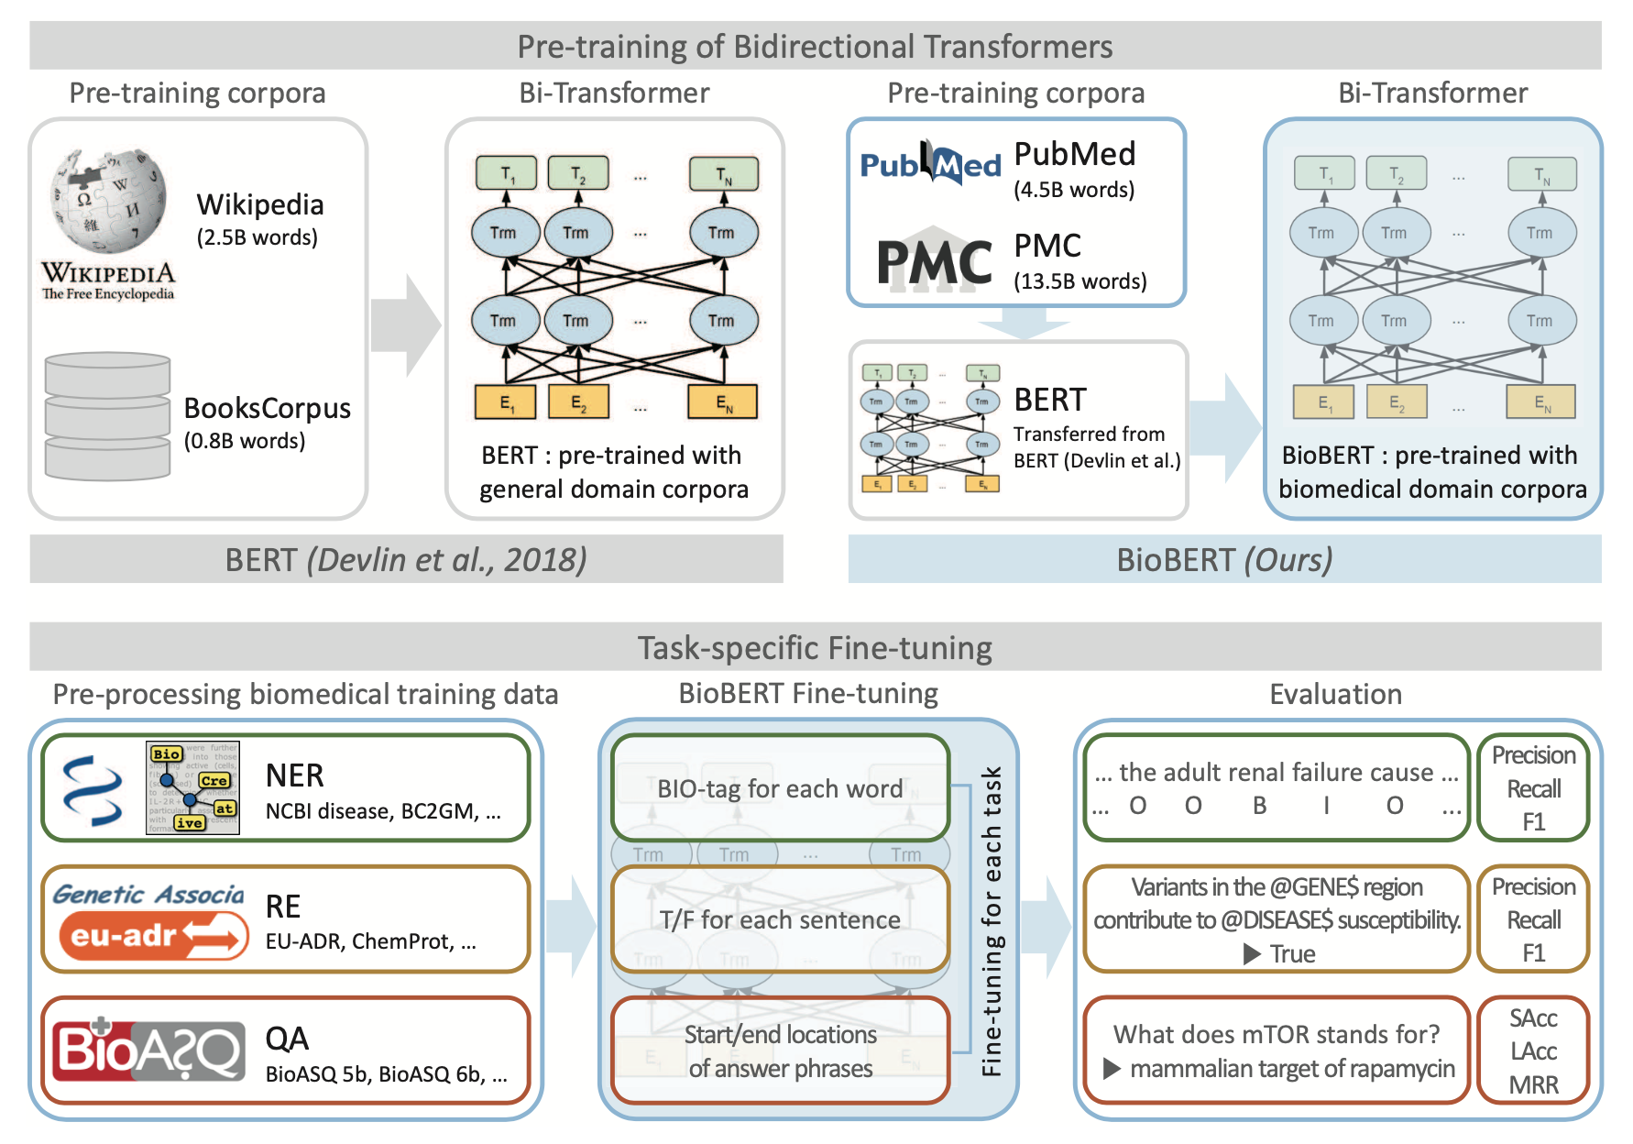

Slide 47
Final Assignment

Slide 48
About the final assignment
Topics to choose from:
Text Classification
Information Extraction
Sentiment Analysis
Argument mining
Data: provided by us
Experiments: choose your own method. You can build on tutorials
Report: 8 pages + max 2 pages for references and appendix (research paper). Advice: use LaTeX on Overleaf
Deadline: January 16.

Slide 49
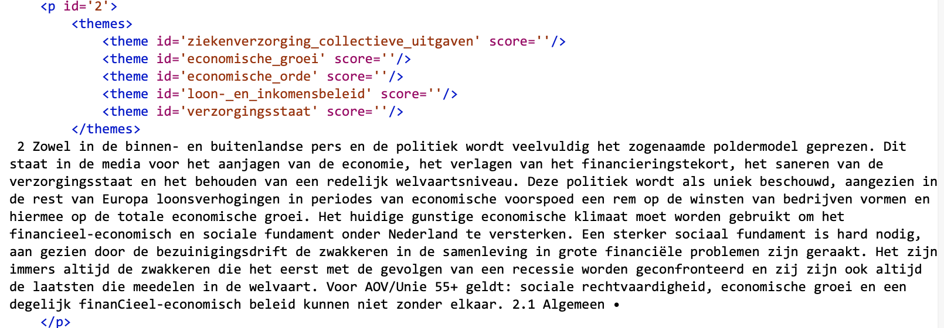
1. Text classification
Multi-label classification of Dutch election political manifestos
Data: Political_election_manifestos.zip (Brightspace)
Paper: Verberne_2014_Automatic thematic classification of election manifestos.pdf (Brightspace)

Slide 50
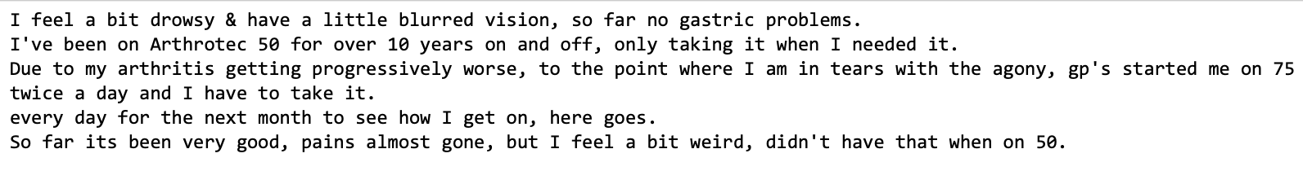
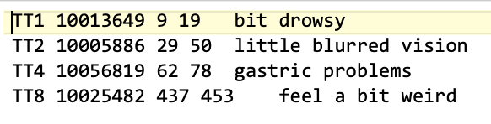
2. Information Extraction
CSIRO Adverse Drug Event Corpus (Cadec)
Data: CADEC.v2.zip (Brightspace)
Paper: Karimi_2015_Cadec- A corpus of adverse drug event annotations.pdf (Brightspace)
cadec/text/ARTHROTEC.1.txt
Transformation to IOB needed (using start and end character positions)
cadec/meddra/ARTHROTEC.1.ann
https://data.csiro.au/collections/collection/CIcsiro:10948/SQcadec

Slide 51
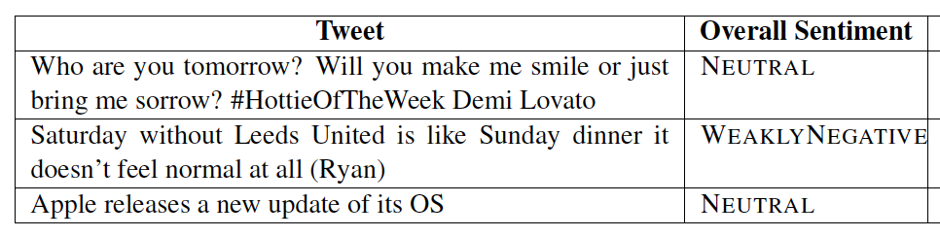
3. Sentiment Analysis
SemEval 2017 Task 4: Sentiment Analysis in Twitter (subtask A)
Data: semeval-2017-tweets_Subtask-A.zip (attached)
Paper: Rosenthal_2017_SemEval-2017 Task 4- Sentiment Analysis in Twitter.pdf
Subtask A: sentiment classification on a fivepoint scale
https://alt.qcri.org/semeval2017/task4/

Slide 52
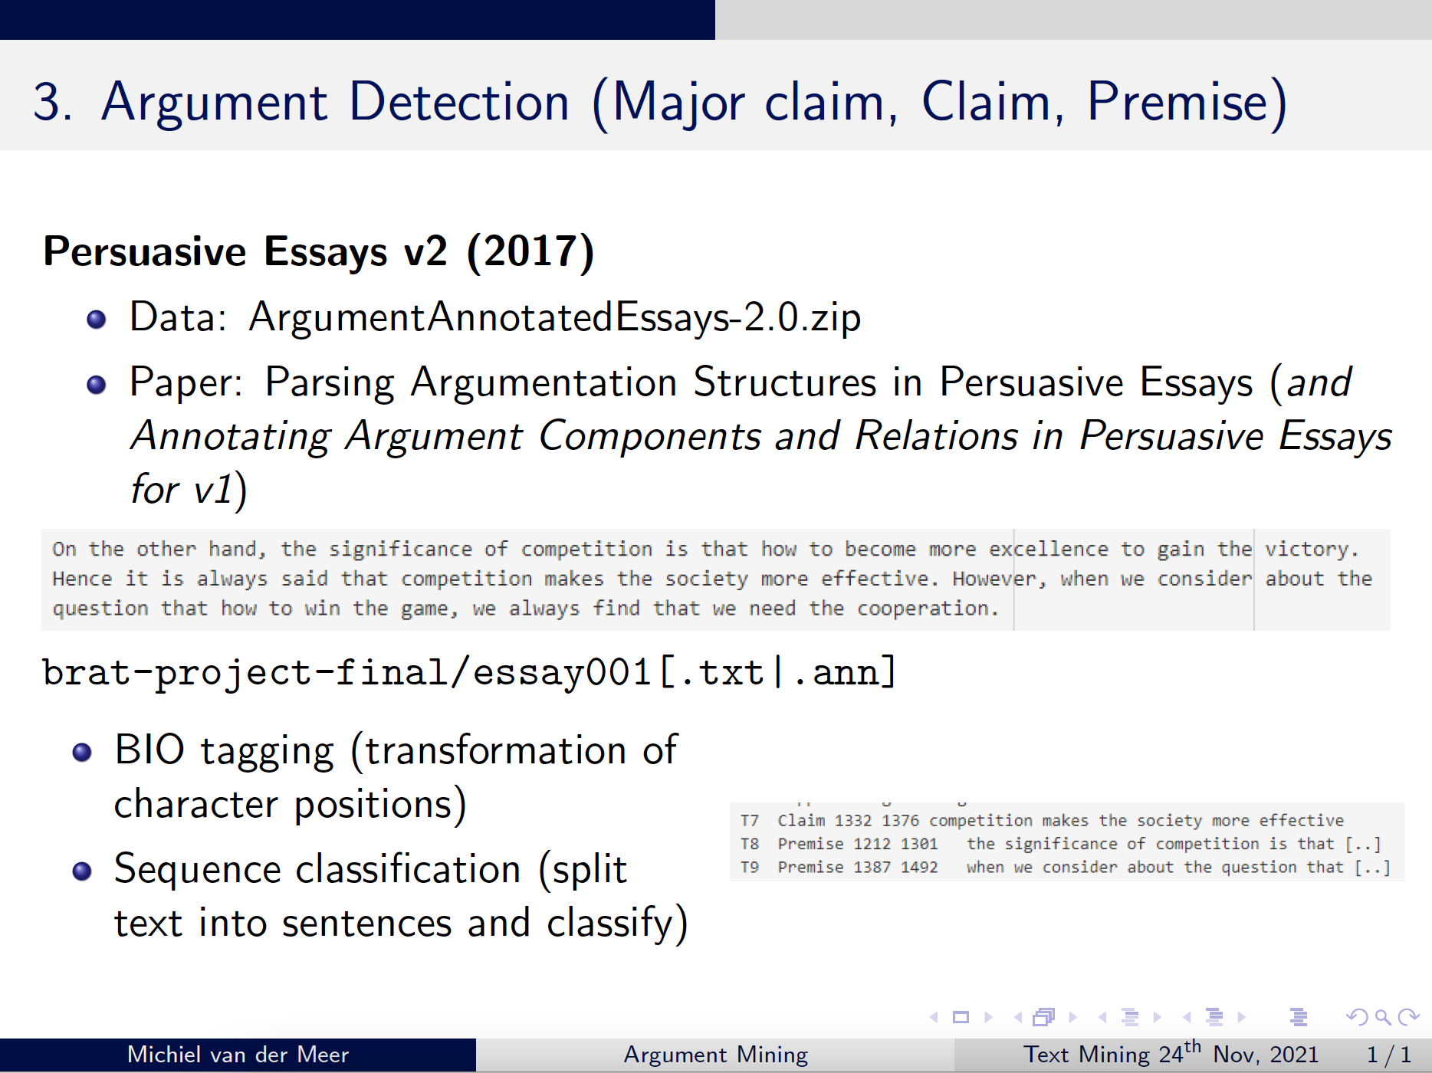
4. Argument mining
4.

Slide 53
Topics
You are allowed to propose your own topic. In that case, submit a proposal on or before December 1st:
One paragraph describing the task (with one or two references to papers)
Your research question(s)
A reference to the data and a table summarizing the data set size
We will provide feedback on this

Slide 54
Research paper structure
Introduction
Background/related work
Data
Methods
Results
Discussion
Conclusion
Contributions of the team members
(Grading criteria can be found on Brightspace: Assignments -> Criteria for final assignment)

Slide 55
General guidelines
Your introduction needs to contain a description of the task and your research questions. What is the problem and how will you solve it?
In your background section you describe a few relevant papers.
In your data section you provide a description and some statistics of the data. What are the labels and how are they distributed?
In your methods section you describe what you did and how
In your results section you provide clear tables with the results, and a description. Don’t forget a baseline comparison
Add relevant points of discussion (limitations, implications)
In the conclusion section you answer your research questions

Slide 56
Deadlines
(December 1: proposal for your own topic; if you want to)
December 6: select a topic (choose one of four)
You don’t have to send this to us
December 15: submit a draft of your introduction and data description sections.
You receive 1 point out of the 10 for the final assignment by completing this step.
January 16: submit the full paper
If your submission is late, then it will be counted as re-sit (maximum grade: 6). The re-sit deadline is January 31st.
Everything can be submitted to the Brightspace item ‘Final assignment’

Slide 57
Conclusions

Slide 58
Homework
Read:
Lee et al. (2020) BioBERT: a pre-trained biomedical language representation model for biomedical text mining
Final assignment:
Do you stay in the same team?
Choose a topic before December 6, or submit your own proposal before December 1.
Next week: guest lecture by Kasper Kok (TextKernel) about text mining in a company context

Slide 59
After this lecture...
You can motivate the use of text mining in the biomedical domain
You give three examples of biomedical research questions that can be answered with the help of text mining
You can describe the text mining components that are needed for biomedical knowledge discovery
You can explain the value of ontologies in the biomedical domain
You can define unsupervised and supervised methods for biomedical entity recognition
You can explain relation extraction using co-occurrences and natural language processing

